Slide 1

Data Science
For Economists

Slide 2
Common Desired Data Science Skills
Data warehousing
Hadoop, Cloud Storage, No SQL
Data Management
SQL, Spark
Scripting/Automation
Python
Statistical Analysis
R, SAS, STATA
Both supervised and unsupervised
Software Development
Java, C, C++
Web development
Javascript, HTML
Cyber security

Slide 3
What an Economist brings to the Data Science field
Modeling
Assumptions
What’s a good/bad assumption? When is a model spitting out nonsense?
Specification
What question needs to be answered, which variables to use
Interpretations
Effect of X on Y, importance of X in model
Coding in R, STATA, SAS
Data Visualization
Statistics Theory

Slide 4
Data Science Vs. Traditional Economics
Economics
Policy analysis
New assumptions and ways of understanding the world
Model interpretations
Data sets are smaller and easier to store
Data Science
Business-related problems
Predictions, not interpretations
Don’t care how the world works, just need answers
Effective data warehousing is a huge issue

Slide 5
Supervised modeling with Machine Learning
Interpretability ←→ Predictability tradeoff
The better a model is at making predictions, the less easily it can be interpreted
This creates the “black box” comparison
Be careful to know what is going in and coming out of the model
It’s easy to evaluate a model that looks better than it is, or that gives nonsensical results because of some small, overlooked factor

Slide 6
Machine Learning Process
0. Prepare data (clean data, define data kinds, etc.)
Split data into training and testing sets
Common split is 80% / 20% (training / testing)
Random splits for cross-sectional data, ordered splits for time series
Select model type
Logistic, Random Forest, Boosted Decision Tree, Neural Network, etc.
Select model inputs (resample wide or unbalanced data)
Train model on training set
Define a grid of model “hyperparameters”
Tune model using “cross validation”
Test best performing model hyperparameter values on testing set to derive accuracy metrics
Repeat from step 2 until the best model is found

Slide 7
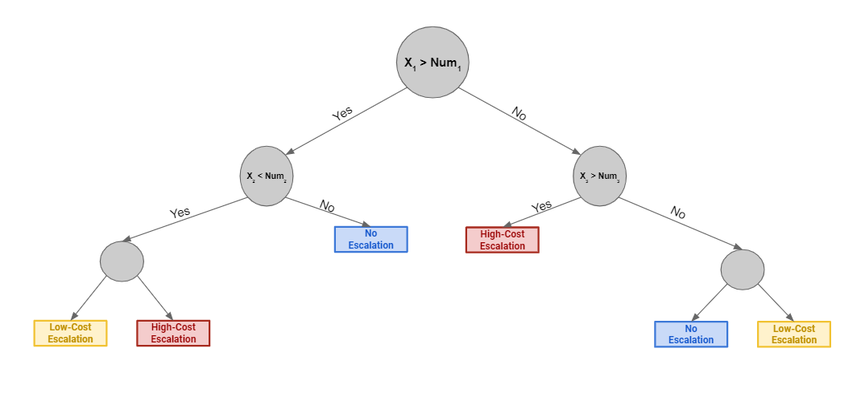
Decision Tree Concept

Slide 8
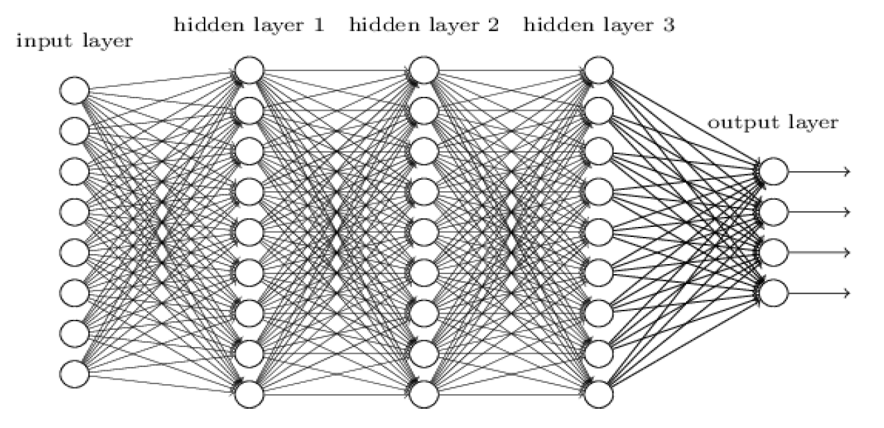
Neural Network Image Source: http://neuralnetworksanddeeplearning.com/chap6.html

Slide 9
Today
Compare a Logit model (traditional econometrics) to a Random Forest (Tree-based algorithm) using the Machine Learning process
Use Logit for interpretations, Random Forest for predictions
Commonly used solution
Explore data visualization tools on R
Set up Microsoft Azure account
Commonly used, cloud-based machine learning environment when data gets too big to manage locally
Python installation
Anaconda v. 3 (Add to PATH)

Slide 10
Further Study
Lynda – Essentials of Python
Data Camp – Machine Learning with R
Data Camp – Unsupervised Learning with R
Data Camp – Tree-based models with R
Varian, H. R. (2014). Big Data: New Tricks for Econometrics. Journal of Economic Perspectives, 28 (2), 3-28.
Ask Dr. Beaumont for this paper

Slide 11
My Contact Info
Michael Keith
mikekeith52@gmail.com
801-413-8264
linkedin.com/in/michaelwkeith/

